Slide 1
SCAN ASSISTANT
Making Sonography Precise and Easy to Use
Pressy Deena Abraham
MA,BS,RDMS

Slide 2
Need For Speed!
“With a small footprint, a relatively low price tag and
advancing technology, ultrasound is the sweetheart of
healthcare.” Monique Rasband Research Director at KLAS(3)
Ultrasound Scanning has seen Exponential Growth
  Vascular
  Breast
  Bowel
  Musculoskeletal
Requirement to Perform Exams Accurately and Quickly
  Growing Demand
  New techniques need to be implemented to keep up with increasing volume.
    Scan Assistant
Notes:
According to Monica Rasband Research Director at KLAS “With a small footprint, a relatively low price tag and advancing technology, Ultrasound is the sweetheart of healthcare.”
Ultrasound has seen exponential Growth as providers are relying on ultrasound as a cost-effective, time-saving solution. Ultrasound is emerging as the primary imaging modality for new markets such as Vascular, Breast, Bowel and Musculoskeletal.
With growing demand and the requirements to perform exams accurately and quickly, automation programs such as scan assistant are taking center stage.
KLAS spoke to 178 providers to find out which ultrasound solutions are delivering the best value and most significant time-savings GE was#1 with Scan Assistant.

Slide 3
What is Scan Assistant?
Customizable Scanning Protocol
Anticipates the Next Step of Your Scan
Automatically:
  Inserts comments
  Initializes and auto-completes measurements
  Steers color Doppler
  Sets up imaging controls and modes
  Re-order images to interpreter’s preference

Slide 4
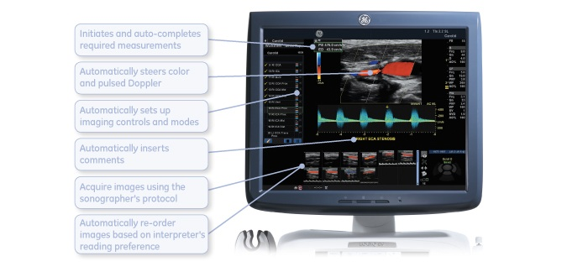
Scan Assistant Screen
Notes:
http://www.auntminnie.com/index.aspx?sec=ser&sub=def&pag=dis&ItemID=92319

Slide 5
Benefits of Scan Assistant
Scan a study from the beginning to end without
having to type any annotations.
Advance Images with one simple push of a button
Use Fewer User Actions
Improves a Sonographer’s:
  Efficiency
  Ergonomics
  Consistency
  Accuracy

Slide 6
Scan Assistant: Efficient
“Up to a 79% reduction in keystrokes and 54% reduction in exam time.” (GE Internal Study) (2)
Abdomen Key Strokes
  65% average reduction in user actions
  423 traditional actions vs 147 Scan Assistant actions
Carotid Key Strokes
  78% average reduction in user actions
  776 traditional actions vs 174 Scan Assistant actions
Notes:
Using Scan Assistant can reduce keystrokes up to 79% and reduce scan time by 54%.
For example in a typical Abdominal exam using Scan Assistant will reduce user action by 65%. In a traditional exam a sonographer performs 423 actions while using Scan Assistant the sonographer only uses 147 actions.
In a Carotid exam key strokes are reduced by 78%. Normal exam without Scan Assistant would consist of 776 actions and with Scan Assistant only 174 actions.

Slide 7
Scan Assistant: Ergonomic
Anatomical Sites of Discomfort in Sonographers
2008 Survey Showed that 90% of Sonographers are scanning in pain (1)
Eyes 45%
Neck 74%
Shoulder 76%
Upper Arm 38%
Forearm 31%
Wrist 59%
Hand/Fingers 55%
Upper Back 58%
Middle Back 33%
Low Back 58%
Hip 25%
Upper Leg 7%
Knee 17%
Lower Leg 12%
Ankle/Foot 20%
Notes:
According to an SDMS 2008 survey 90% of Sonographers are scanning in pain. The following are sites of discomfort for Sonographers.

Slide 8
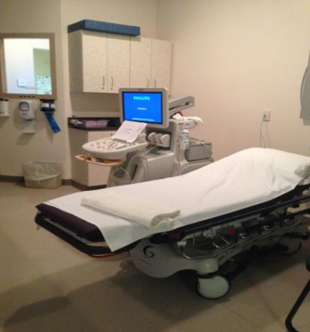
Scan Assistant: Ergonomic
  Reduction in Key Strokes
    Decreases the duration of static
    posture
    Minimizes awkward postures
    Reduces the chance of injury by
    allowing a sonographer to scan
    without reaching over to the keyboard
Scans either side of a large
patient without turning off the
machine or finding a second set
of hands to help.
Notes:
Using Scan Assistant helps improve Sonographer ergonomics in two main ways one by reducing key strokes. Which decreased the duration of static posture, minimizes awkward postures and reduces the need for sonographers to reach over to the keyboard. The second way is that Scan Assistant allows the sonographer to scan large patients from either side of the bed. For example if you have an ICU patient and you are trying to scan the left kidney. Such a scenario can be very difficult. I often just move to the left side and scan from there. I can get a better angle on the kidney and visualize it better and I don’t have to call one of the nurses to help me control the machine.

Slide 9
Scan Assistant: Consistency
Create Consistent Exams
  All exams can be the same number of images and scanned in the same order each and every time.
  Uniform Studies throughout the department
Rearrange Images
  Put images in a consistent arrangement for faster interpretation
  Achieve higher accuracy with consistent image arrangements
Notes:
Using Scan Assistant can help to create consistent exams. All exams can be the same number of images and scanned in the same order each and every time. Studies can be uniform throughout the whole department.
Scan Assistant also allows the user to rearrange the images to put them in a consistent arrangement for faster and more accurate interpretation.

Slide 10
Scan Assistant: Accurate
Decrease in Scan Time
  Focus on image quality and pathology
  Patient Care
Never Forget an Image
Notes:
We have seen that Scan Assistant is able to provide more accurate interpretation by being able to rearrange images.
Scan Assistant also allows the Sonographer to decrease scan time which enables the sonographer to focus on image quality and pathology which helps to improve patient care.
A great benefit of Scan Assistant is never having to wonder if you forgot an image.
Say for instance you have scanned 6 pregnancy in a day, on a typical exam you have to think through or review your images to see if you forgot that four chamber heart on the 6th pregnancy. Or if you are scanning a patient at 3am in the morning. Using Scan Assistant you can see right away that you didn’t and you can eliminate the need to call back the patient for the one view that “wasn’t clear”.

Slide 11
Other Holistic Benefits
Scan Assistant saves time and money
Easier reading for Radiologists by developing modality specific Scan Assistant Protocols
Efficiencies allow the Sonographer to concentrate on providing better patient care
Notes:
Using Ultrasound a more cost effective modality saves money in general but with the use of Scan Assistant the number of patients that can be seen increases and thus increases the bottom line.
The Simplicity of Scan Assistant allows Radiologist to quickly read exams.
Scan Assistant does the little things for you so you can focus on the important elements of the scan and provide better patient care.

Slide 12

My Personal Experience
“One of the greatest tools I have used in my 10+ years of scanning!”
  My Timing for Exams with Scan Assist
Carotid - under 10 minutes
B/L LE Venous - under 13 minutes
Renal exams - under 5 minutes
Abdomen exams - under 15 minutes
Notes:
Now I told you Scan Assistant is one of My favorite tools but not everyone uses it. Which I think is a complete sin . But by implementing Scan Assistant into your scanning routine you can come out looking like a Rock Star Sonographer.
As a new Sonographer I remember hearing the legends of a 10 minute Carotid. In the beginning a Carotid can be a very long exam with all the heel toeing, angling, turning on and off all the different modes and steering. Now I was joking with my Co Worker who had worked in the field for over 30 years that I may be close to scanning a 10 minute Carotid. He completely did not believe me. So he said well IF you finish under 20 minutes I will take the patient back for you. If any of you have pushed those stretchers around you know that getting and taking back your patients can be almost as time consuming as scanning the patient. By using Scan Assistant I scanned a carotid in 9 minutes and 4 seconds. And got my co worker to take back the patient and be back in time to promise never to bet against me again.

Slide 13
The Moral of the Story
Scan Assistant enables you to
“Make it Easy and Make it Your Own.” (GE)
With practice and preparation using Scan Assistant, reduces your
scan time by over 50%
Images will be more consistent and accurate
Scan Assist promotes ergonomics which can reduce pain/injuries
Sonographers suffer over time
Saves Time and Money!
Notes:
GE Healthcare’s Scan Assistant, which automates the more routine aspects of an ultrasound examination, thereby helping reduce keystrokes and repetitive motion and, as a result, allowing a sonographer to focus on the patient rather than the machine.
“In all, this means that the use of Scan Assistant could improve the patient experience while streamlining the ultrasound exam process by allowing sonographers to exam more patients while still reducing overall keystrokes,” adds Dennis Meister, marketing manager for GE Healthcare’s ultrasound products

Slide 14
Questions
?
Notes:
I’d like to take this time to answer any questions you may have for me.

Slide 15
References
“KLAS looks at which ultrasound vendors are delivering the best value and time savings” KLAS (2014 May 13) Retrieved from http://www.klasresearch.com/news/pressroom/2014/Ultrasound
Murphy, Carmel and Andre Russo “An Update on Ergonomic Issues in Sonography” SDMS(2008 July) Retrieved from https://www.sdms.org/pdf/sonoergonomics.pdf
“Technology Update: Ultrasound.” Radiology Today 11.11 (2010 November): 10 Retrieved from http://www.radiologytoday.net/archive/rt1110p10.shtml
“What is Scan Assistant?” AuntMinnie.com (2010 October 12) Retrieved from http://www.auntminnie.com/index.aspx?sec=ser&sub=def&pag=dis&ItemID=92319

